Slide 1

Introduction to Access & VBA
Notes:
http://www.functionx.com/vbaccess/Lesson01.htm

Slide 2
A database is
a list of items stored somewhere to make their values easy to access or retrieve. This means that a database can exist anywhere, including human or non-human memory.
A computer DB is a list or a group of lists created as a project.
There are various types of applications used to create such a list. To make it more useful, special computer applications are developed to create & manage computer databases.

Slide 3
Various Libraries for a Database
Because there are many requirements & many options for computer DBs, there are also various techniques of creating a database. By its basic definition,
a database is primarily one or more lists.
How the list(s) is (are) created can depend on various circumstances. To make it possible to create DBs,
various libraries have been developed
& you use one of these libraries to do a job:

Slide 4
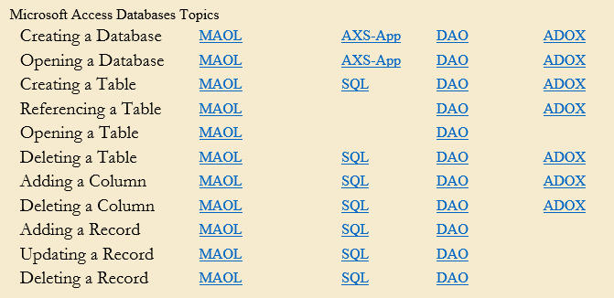
Various Libraries for a Database
Microsoft Access Object Library
Microsoft Data Access Object (DAO)
Microsoft ActiveX Data Objects (ADO)
Microsoft ADOX (ADOX)
ADO.NET
Win32 API

Slide 5
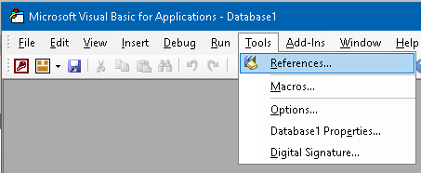
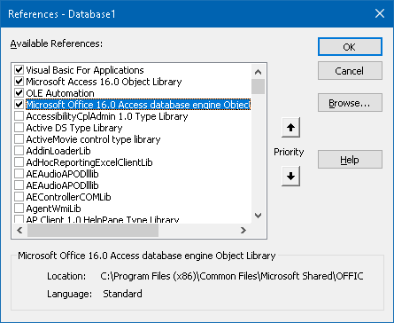
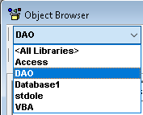
Various Libraries for a Database

Slide 6
MS Access Object Library (MAOL)
provides its own mechanism for creating & managing a DB.
It provides most of the tools you need to start & complete a DB project. Access is also equipped with a library, the MS Access Object Library that you can use to programmatically create and manage databases. This library is already available to you so you don't have to "load" it.

Slide 7
Microsoft Data Access Object (DAO)
is a library that ships with Access & allows you to create, maintain & manage DBs + provides means of performing the necessary operations on a DB.

Slide 8
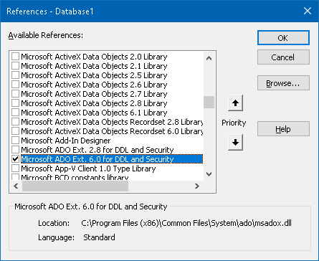
Microsoft ActiveX Data Objects (ADO)
is a library that was developed to allow programmers with other environments to create & manage MS Access DBs.
To support this, it provides a driver that allows these other programming environments to "attach" their applications to Access DB. Like Access' own library, you can use ADO inside of Access to fully create and manage a database

Slide 9
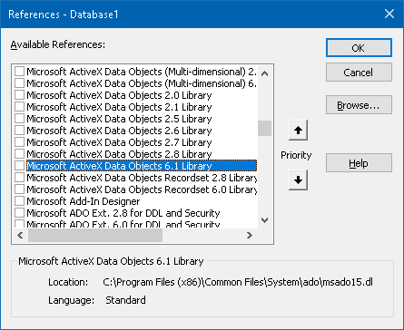
Microsoft ADOX
Microsoft ActiveX Data Object Extensions for Data Definition Language and Security, also called ADOX, is an addition to ADO. Besides many of the ADO operations it can perform, you can use it for additional assignments such as creating a database.

Slide 10
Various Libraries for a Database
ADO.NET:
is a technique developed by MS, it is part of the .NET Framework.
This technology allows you to use one or more libraries of the .NET Framework and one or more of the languages of the .NET Framework to create and manage a DB. Although its name includes ADO, ADO.NET is neither ADO nor a real library, it is a technique of creating and managing dbs. For example, while ADO contains objects and collections, ADO.NET does not own anything (because it is not a library; it is only a concept of dealing with db).
Win32 API: A library is practically never complete. To complement those cited above, you can use others. One the external libraries you can use is called Win32. It belongs to Windows & is already installed with the operating system. Because most of its functions are written in C, they cannot be directly used in a Access database: you must import them.

Slide 11
Creating an Access Database
Notes:
http://www.functionx.com/vbaccess/Lesson01.htm

Slide 12
Visually Creating Access DB
There are various ways you can create a DB. To visually start a DB from scratch, after launching Access, you can click Blank Database. In the right section, accept or change the name of the database. If you want to create an Access 2010+ database, either omit or add the .accdb extension. If you want to create a database that is compatible with previous ver of Access, you must add the extension .mdb.
After specifying the name, to specify a folder of your choice, under File Name and on the right side of the name of the database, click the Browse button . This would open the File New Database dialog box. You can click the arrow of the Save In combo box to select a drive such as (A:), (C:), etc. After selecting the drive, you can either select an existing folder or create a new folder by clicking the Create New Folder button on the right side of the Save In combo box. You can also use a directory on the network as the repository of the new database.
After specifying a drive and a folder, you can click Create.

Slide 13
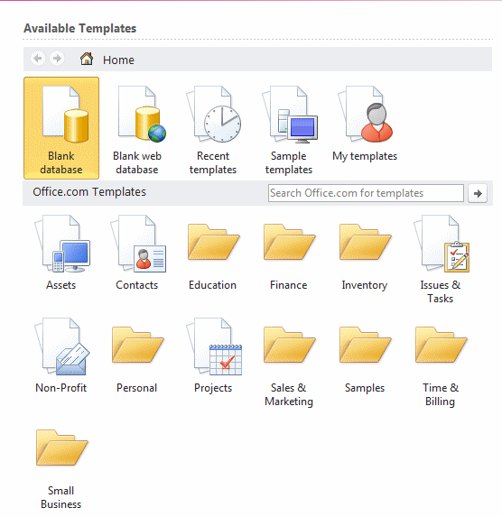
Creating a Database Using a Wizard
Access ships with a few sample databases you can use and customize. To create a database from a template, after launching Access, in the middle section, locate one under Available Templates:
Notes:
http://www.functionx.com/vbaccess/Lesson01.htm

Slide 14
The Data Definition Language Components
SQL language is broken up into three components:
Data Definition Language,
Data Manipulation Language,
Data Control Language.
DDL | DML | DCL
is used to
create tables & establish relationships among tables | manage the database by performing such operations as retrieving, updating, deleting & navigating through data | provide security to data in a database
CREATE TABLE DROP TABLE ALTER TABLE CREATE INDEX | INSERT INTO SELECT INTO UPDATE DELETE SELECT UNION TRANSFORM PARAMETER | ALTER DATABASE CREATE GROUP DROP GROUP CREATE USER ALTER USER DROP USER ADD USER GRANT PRIVILEGE REVOKE PRIVILEGE

Slide 15
Microsoft Visual Basic Fundamentals
Notes:
http://www.functionx.com/vbaccess/Lesson01.htm

Slide 16
MS Visual Basic Fundamentals
You can create a good performing DB using only Access.
To create a more complex database, you would have to write code. To support this, Access ships with a programming environment named MS Visual Basic. This is a variant of the MS Visual Basic.
In order to access Visual Basic, you must first create or open a DB in Access. Then, on the ribbon, you can click the Database Tools tab. In the Database Tools section, you can click the Visual Basic button . This would open Visual Basic:

Slide 17
Access offers you Tables, Queries, Forms, Reports, Macros & Modules.
Tables. All data is stored in tables. When you create a new table, Access asks you define fields, giving each a unique name, and telling Access the data type. Use the "Text" type for most data, including numbers that don't need to be added e.g. phone numbers or postal codes. Once you have defined a table's structure, you can enter data. Each new row that you add to the table is called a record. To define relationships between tables: Database Tools | Relationships
Queries: to find or operate on the data in your tables. With a query, you can display the records that match certain criteria, sort the data as you please, and combine data from different tables. You can edit the data displayed in a query, and the data in the underlying table will change. Special queries can also be defined to make wholesale changes to your data, e.g. delete all members whose subscriptions are 2 years overdue, or set a "State" field to "WA" wherever postcode begins with 6.
Forms. These are screens for displaying data from and inputting data into your tables. The basic form has an appearance similar to an index card: it shows only one record at a time, with a different field on each line. If you want to control how the records are sorted, define a query first, and then create a form based on the query. If you have defined a one-to-many relationship between two tables, use the "Subform" Wizard to create a form which contains another form. The subform will then display only the records matching the one on the main form.

Slide 18

Tables, Queries, Forms, Reports, Macros, Modules
Reports. If forms are for input, then reports are for output. Anything you plan to print deserves a report, whether it is a list of names and addresses, a financial summary for a period, or a set of mailing labels.
Macros. An Access Macro is a script for doing some job. For example, to create a button which opens a report, you could use a macro which fires off the "OpenReport" action. Macros can also be used to set one field based on the value of another (the "SetValue" action), to validate that certain conditions are met before a record saved (the "CancelEvent" action) etc.
Modules. This is where you write your own functions and programs if you want to. Everything that can be done in a macro can also be done in a module, but you don't get the Macro interface that prompts you what is needed for each action. Modules are far more powerful, and are essential if you plan to write code for a multi-user environment, since macros cannot include error handling.

Slide 19
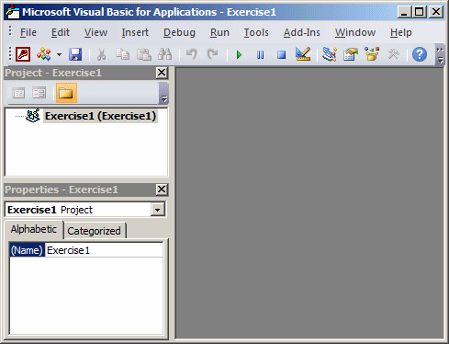
This would open Visual Basic (ALT+F11):

Slide 20
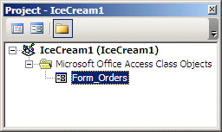
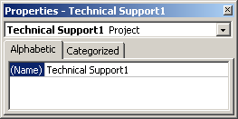
Visual Basic Child Windows
The Project window displays the coding objects available for your DB (Project Explorer CTRL+R)
Every object & item of your DB has characteristics, called properties, associated with it. You control those properties when you design the object. For example, when you are designing a form in Access, you define what its caption would be. You can as well have access to these properties in VB via Properties Window (F4) when the object is selected.

Slide 21
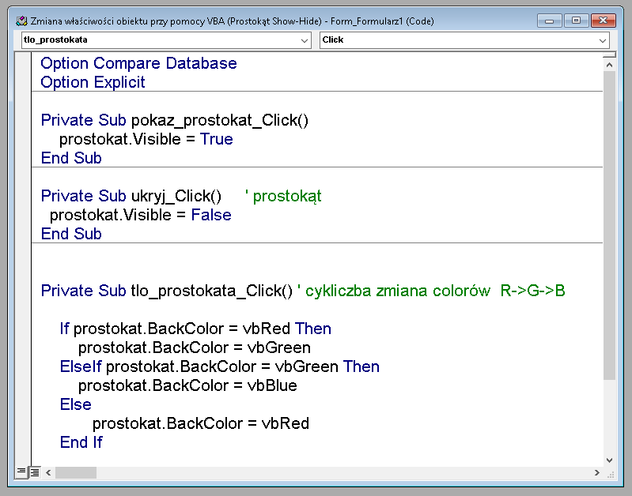
The Code Editor

Slide 22
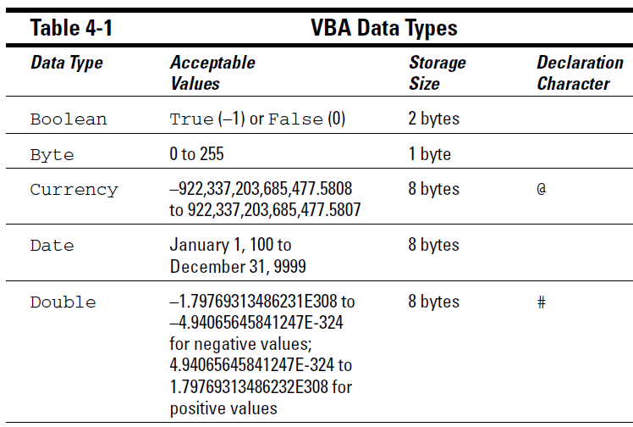
VBA Data Types
VBA Data Types

Slide 23
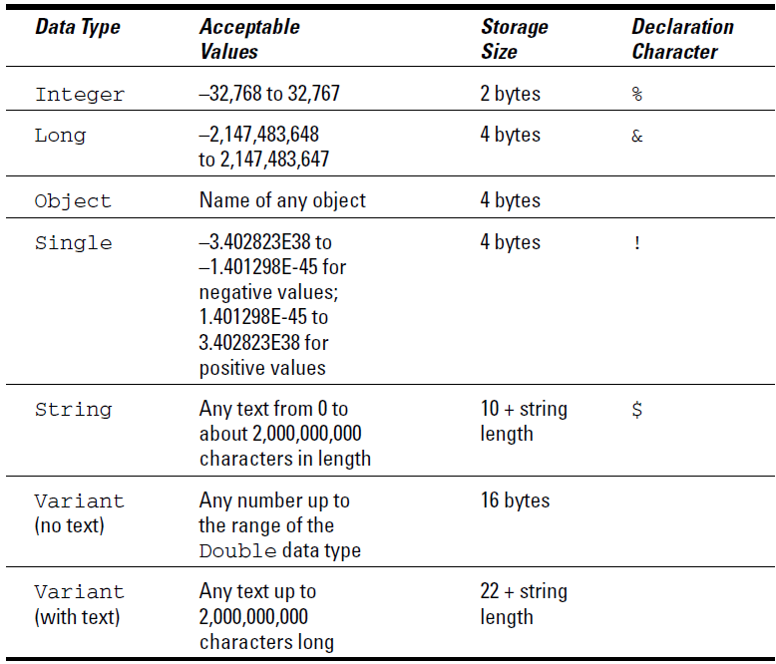

Slide 24
Introduction to Objects
Notes:
http://www.functionx.com/vbaccess/Lesson01.htm

Slide 25
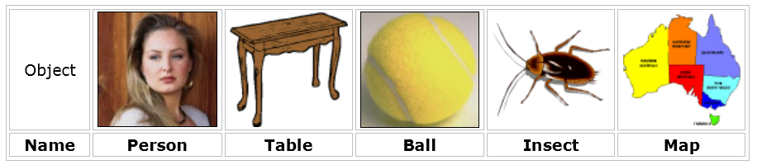
An Object
is anything that can be described.
In the real world, examples of objects are: the moon, a ball, a hand, a book, a head, a song, a box.
As different as objects are, they follow some basic rules used to describe them. A characteristic of an object is a word/group of words used to describe the object. Some characteristics are applied to all objects, ie. every object must be identified with
a word or a group of words referred to as its Name:

Slide 26
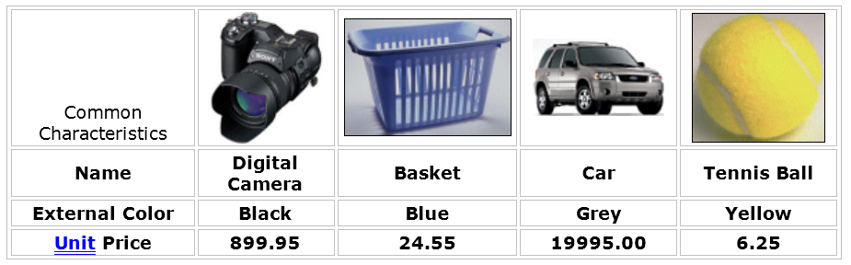
Introduction to Objects
Some characteristics apply to a group of objects but don't apply to another group. For example, a characteristic called width can be used to describe a car, a medical pill, a piece of paper, or a computer monitor:

Slide 27
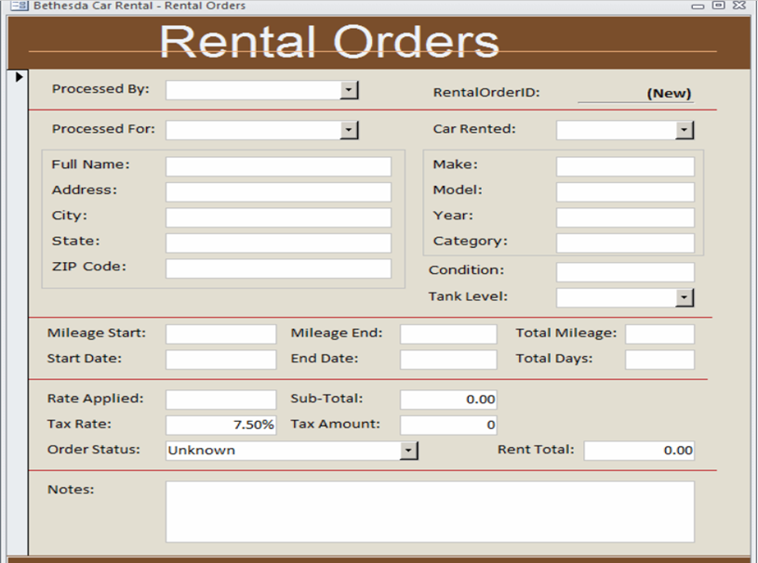
Introduction to Objects
When creating a DB, you will also use objects but these are referred to as Windows controls.
In a typical application, you will choose the objects, that is, the controls that you judge necessary and you will make them part of your application.
Here is an example:

Slide 28
In the programming world, a characteristic of an object is referred to as a property of that object. For example, as mentioned above, every object must have a name. The name is used to identify the object.
Because every object has properties, they can be created as a list:
The properties of each object are: its name, its external color, and its unit price. This can be illustrated as:
Object
Property Name
Name
External Color
Unit Price

Slide 29
To represent an object, that is, to describe it, you can give a value to each property. For example, the properties of the digital camera from the above table are its Name, its External Color, and its Unit Price. The values of the properties of that camera are: Name: Digital Camera, External Color: Black, Unit Price: 899.95. This can be illustrated as:
Object
Property Name Property Value
Name Digital Camera
External Color Black
Unit Price 899.95
From this illustration, it is important to make a distinction between a property and its value: a property is a word or a group of words used to define what constitutes an object. A value is the word or a group of words used to formally describe an object. In the programming world, the name of a property is always of one word only, as the Name property in the above table. If a name is made of more than one word, then they must be combined into one. In the same way, the value of a property is made of only one word. Also, if the name is a combination of words, they must be concatenated (added) to produce one word. Based on this, the properties and their values from the above table would be:
Object
Name
External Color
Unit Price

Slide 30
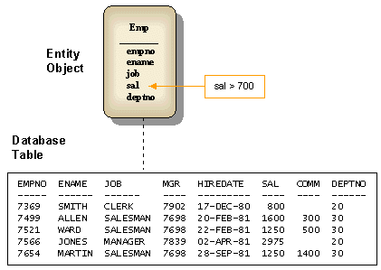
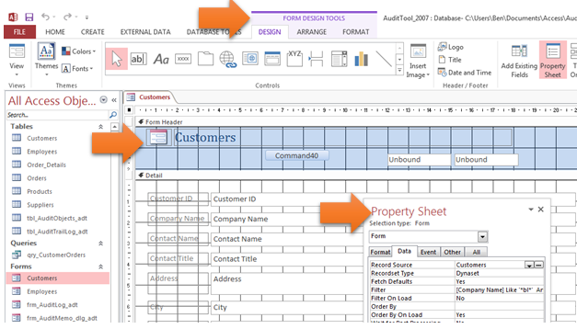
Objects to represent a database
In the real world, Access also relies on objects to represent a DB.
The most regularly used objects of a database is called a table.
Another used object of an application is called a form.

Slide 31
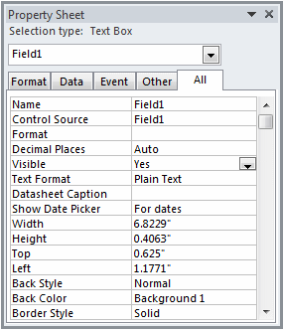
Visually Accessing the Properties of an Object
Each object has properties.
During the design of an object, you can use the Properties window that represents its properties.
For a form, the Properties window appears as a resizable horizontal window with 5 tabs:
Format, Data, Event, Other, All:

Slide 32
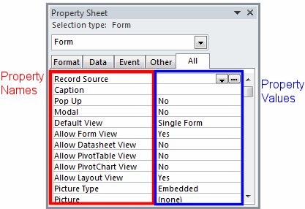
To visually configure a property, you must first locate it in the Properties window. The properties are categorized in 3 tabs: Format, Data, Other. All of these properties are also represented in the All tab.
Each property appears with its name as in the real world: in different words. Examples are Caption, Default View, or Min Max Buttons.
After locating the property, to see or change its value, you use the box on its right. This means that a property is made of two sections: a property name & a property value.

Slide 33
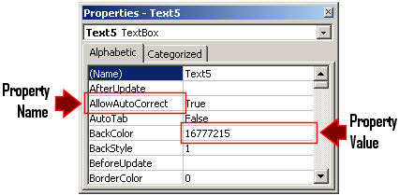
If you are working in Visual Basic, you can use the same approach to change a property using the Properties window. This time, the names of properties appear in one word and they are in their official format:

Slide 34
Programmatically Accessing the Properties of an Object
To change a property, in your code, type the name of its object, followed by a period operator ".", followed by the official name of the property, followed by the assignment operator, and followed by the desired value.
This means that you must know the
name of the object whose property you want to change
name of the property you want to change,
possible values that the property can receive.
An example of code that hides a rectangular box, named Rectangle, when the user clicks a button:
Private Sub cmdHide_Click()
Rectangle.Visible = False
End Sub

Slide 35
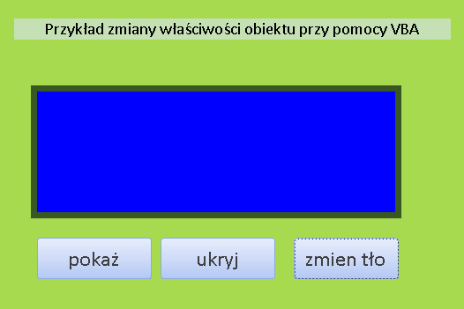
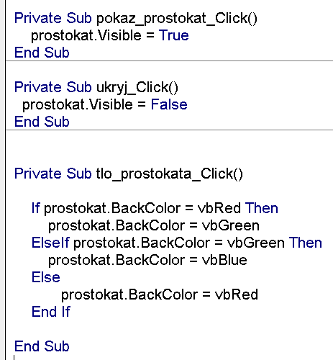
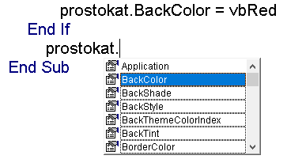
Zmiana właściwości obiektu przy pomocy VBA (Prostokąt Show-Hide).accdb
Notes:
Private Sub pokaz_prostokat_Click()
prostokat.Visible = True
End Sub
Private Sub ukryj_Click()
prostokat.Visible = False
End Sub
Private Sub tlo_prostokata_Click()
If prostokat.BackColor = vbRed Then
prostokat.BackColor = vbGreen
ElseIf prostokat.BackColor = vbGreen Then
prostokat.BackColor = vbBlue
Else
prostokat.BackColor = vbRed
End If
End Sub

Slide 36
The Properties of an Object
If you need to change various properties to perform a specific task you can type the name of the object, followed by the period operator, followed by the name of the property, press Enter, and do the same on the next line.
An example:
Private Sub param_prostokata1_Click()
prostokat.BackStyle = 1
prostokat.BackColor = vbYellow
prostokat.BorderColor = vbBlack
prostokat.BorderWidth = 4
prostokat.SpecialEffect = 0
prostokat.BorderShade = 1
prostokat.Width = 2200
End Sub

Slide 37
With the Properties of an Object
As an alternative, instead of typing the name of the control over and over again.
On the right side of the With keyword, type the name of the control whose properties you want to access. Under the With ObjectName line, type your statements and expressions as you wish but start each property of the ObjectName with the period operator ".". At the end of the With statement, type End With:
Private Sub zmiana_par_z_WITH_Click()
With prostokat
.BackStyle = 1 ' 0 - kolor tła
.BackColor = vbCyan
.BorderColor = vbBlue
.BorderWidth = 3
.SpecialEffect = 0
.BorderShade = 50
.Width = 4500
End With
End Sub

Slide 38
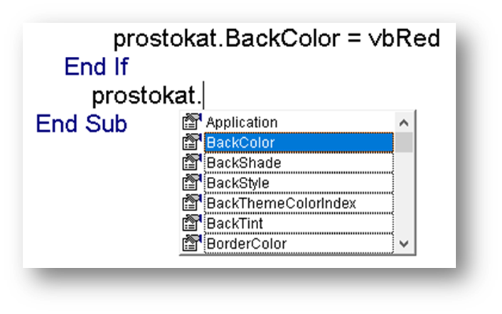
Using the IntelliSence
When writing code, the Code Editor is equipped to assist you with the names of available properties. When you type the name of a object followed by the period operator, the available properties would appear in a list (This feature is called IntelliSense):

Slide 39
The names of objects are usually in one word
Access is very flexible and allows you to use more than one word to name an object (the properties names are always in one word). If you have an object that is made of more than one word, when referring to it in an expression, whether in the Properties window or with your code, you must include it between the brackets [ ]. For example, suppose that you have a box named Rectangular Box instead of boxRectangle. The above code would be written as:
Private Sub cmdHide_Click()
[Rectangular Box].Visible = False
End Sub
There is no penalty if you always include the name of an object in square brackets when referring to it whether in the Properties window or with code, even if the name is made of one word. Here is an example:
Private Sub cmdHide_Click()
[boxRectangle].Visible = False
End Sub

Slide 40
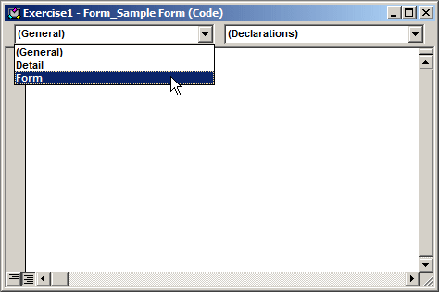
Introducing Properties
In the Projects window, expand Access Class Objects
& double-click Form_Sample Form. Notice that the Properties window displays the characteristics of the form
In the Object combo box of the Code Editor, select Form

Slide 41
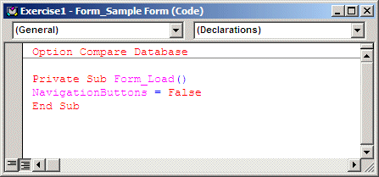
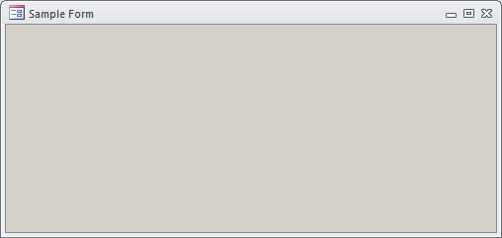
Type NavigationButtons = False
To return to Microsoft Access, on the Standard toolbar, click the View MS Access button
Right-click the title bar of the form and click Form View
After viewing the result, right-click the form (anywhere on it) and click Design View

Slide 42
Text-Based Properties
To programmatically specify or change the text property of an object, if the property is called Text, it is considered the default property of the control. This means that, to specify the value of that property, simply type the name of the control and assign the desired string. An example:
Private Sub SpecifyFullName_Click()
FullName = "Patrick Dong"
End Sub
If the property is named Caption, type the name of the object, followed by a period, followed by Caption, and assign the desired string. Here is an example:
Private Sub Action_Click()
Properties.Caption = " Zmiana parametrów figury"
End Sub
During design, the text or caption you provide to the control is static. This means that you can only provide a fixed value for the control. If you want the text to change in response to something, you must write code. Here is an example:
Private Sub CurrentDate_Click()
Caption = Date
End Sub
With this example, every time the button is clicked, the form would display today's date.

Slide 43

Adding a Control to a Form
In the Controls section of the Ribbon, click Text Box and click the top section of the form
A property is referred to as numeric when its value must be a number. To programmatically specify the value, access the object's property and assign the desired value:
Private Sub ChangeHeight_Click()
Detail.Height = 1450
End Sub
In the Properties window, some fields appear empty. The values of most of those properties depend on other characteristics of an object. To programmatically set the property, use the approach we reviewed earlier: the name of the property, the assignment operator, and the desired value.
A Boolean property is one whose value can be True or False. To programmatically specify or change a Boolean property, access it by its name and assign True or False to it. Here is an example:
Private Sub HideRecordSelector_Click()
RecordSelectors = False
End Sub

Slide 44
Adding a Control to a Form
Some properties use intermediary values. Programmatically changing the value of an action field depends on the type of property. If the property requires a file, you can assign the name and/path of the file to the property. Here is an example:
Private Sub Action_Click()
Picture = "C:\My_Pictures\business.gif"
End Sub
In some other cases, you may have to provide more values than that.
To programmatically specify or change the value of a list-based property, you must know either the name of the value or its equivalent constant integer. Here is an example:
Private Sub cmdAction_Click()
FullName.FontWeight = 600
End Sub

Slide 45
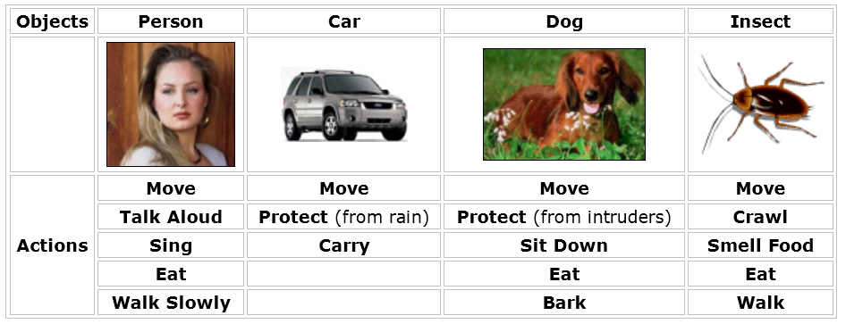
The Methods of an Object
As opposed to being described, an object can perform actions. For example, a Person object can sing. A Car object can move. An Insect object can crawl. A Basket object can hold some clothes. Here are examples of actions:

Slide 46
Notice that some objects can perform similar types of actions. For example all objects of this table can move. Some objects can perform actions that some others can't. For example, from the objects in the above table, a person and a dog can eat.
In the programming world,
an action that an object can perform is called a method.
A method must have a name. On the above table, notice that the name of a method usually resembles a verb (Bark, Eat, Drink).
To make a distinction between a property and a method we will always follow the name of a method with empty parentheses:
Move() or Bark().
Like a property, the name of a method is always in one word.
If the name is a combination of words, each part starts in uppercase:
TalkAloud(), SmellFood(), EatGrass(), ProtectFromRain().

Slide 47
Accessing the Methods of an Object
Because a method is performed, it cannot be represented in a window such as the Properties window. Eventually, we will know how to identify and use the methods of an object. Using a method is referred to as calling it. When a method can produce a result, it can be assigned to a property.
To call a method, if it produces a result that can be applied to a property, if you are working in Access, in the Properties window, locate the property that will use the result of the method. In the property value section, type the assignment operator "=", followed by the name of the object that owns the method, followed by a period operator, followed by the name of the method and followed by parentheses.
To programmatically call a method, type the name of the object that owns the method, followed by a period operator, and followed by the name of the method .

Slide 48
Variables and Data Types
Notes:
http://www.functionx.com/vbaccess/Lesson03.htm

Slide 49
A variable
is a value that you "put" into the computer memory when necessary. The value is lost when the application closes. To proceed, you must communicate to the computer that you will need a portion of its memory to hold a certain value.
Communicating your intention is also referred to as declaring a variable. Because there can be various values used while the application is running, the computer would need two pieces of information to hold a value: a name that can be used to identify the portion of memory and the amount of memory that will be necessary to store the value.

Slide 50
The Name of a Variable
The rules are those of MS Visual Basic (and not Microsoft Access):
The name must begin with a letter (a..z, A..Z) or an underscore _
The name cannot contain a period (.) or a special character (! @ # $ % ^ & * ( ) _ + - = [ ] { } ; ' : " , . / < > ? \ | ` or ~)
The name must not contain an empty space
The name must not exceed 255 characters. You should limit the name of a variable to 30 characters
The name must be unique in the same scope

Slide 51

Introducing Variables
In the Navigation Pane, on the Ribbon, click Create
In the Forms section, click Form Design
In the Tools section of the Ribbon, click the View Code button
In the Object combo box, select Detail In the Procedure combo box, select Click if neessary
Press Tab and type the following: Private Sub Detail_Click()
SomeColor = vbRed
Detail.BackColor = SomeColor
End Sub
In Access display the form in Form View
Click the form and notice that it appears red

Slide 52
Variable Declaration
When writing your code, you can use any variable just by specifying its name. When you provide this name, the computer directly creates an area in memory for it. Visual Basic allows you to directly use any name for a variable as you see fit. If you use various variables like that, this could result in some confusion in your code. As mentioned earlier, you can first declare a variable before using it.
To declare a variable, you use the Dim keyword followed by the name of the variable:
Private Sub Form_Load()
Dim BackgroundColor
End Sub
Declaring a variable simply communicates the name of that variable. You can still use a mix of declared and not-declared variables. If you declare one variable and then start using another variable with a similar but somewhat different name, Microsoft Visual Basic would still consider that you are using two variables. This can create a great deal of confusion because you may be trying to use the same variable referred to twice. The solution to this possible confusion is to tell Microsoft Visual Basic that a variable cannot be used if it has not been primarily declared. To communicate this, on top of each file you use in the Code Editor, type
Option Explicit This can also be done automatically for each file by checking the Require Variable Declaration in the Options dialog box.

Slide 53
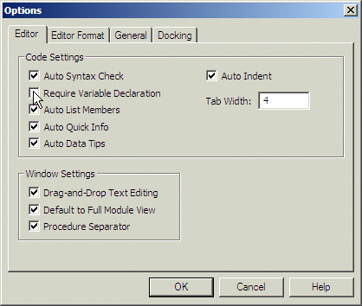
On the main menu of Visual Basic, click
Tools -> Options...
Click the Editor property page. In the Code Settings section, put a check mark in the Require Variable Declaration check box:

Slide 54
Value Conversion
Every time the user enters a value in an application. That value is primarily considered as text. This means that, if you want to use such a value in an expression or a calculation that expects a specific value other than text, you must convert it appropriately. Fortunately, Visual Basic provides an effective mechanism to convert a text value to one of the other values we will see next.
To convert text to another value, there is a function adapted for the purpose and that depends on the type of value you want to convert it to.

Slide 55
Data Types
A data type tells the computer the kind of value you are going to use. There are different kinds of values for various purposes. Before assigning a data type to a variable, you should know how much space a data type will occupy in memory. Different variables or different data types use different amounts of space in memory. The amount of space used by a data type is measured in bytes.
To specify the data type that will be used for a variable, after typing Dim followed by the name of the variable, type the As keyword, followed by one of the data types we will review next. The formula used is:
Dim VariableName As DataType
This technique allows you to declare one variable on its line. In many assignments, you will need to declare more than one variable.
To do this, you have two alternatives. You can declare each variable on its own line. This would be done as follows:
Dim Variable1 As DataType1
Dim Variable2 As DataType2
Dim Variable3 As DataType3

Slide 56
Data Types
You can also declare more than one variable on the same line. To do this, use only one Dim keyword but separate each combination of a name and data type with a comma. This would be done as follows:
Dim Variable1 As DataType1, Variable2 As DataType2
Dim Variable3 As DataType3

Slide 57
Private Sub Detail_Click()
Dim EmployeeIsFullTime As Boolean
Dim FullName As String
Dim EmploymentStatus As Byte
Dim YearHired As Integer
Dim DaysOnJob As Long
Dim SickTime As Single
Dim WeeklyTime As Double
Dim HourlySalary As Currency
Dim DateHired As Date
End Sub
Variant can be used to declare any kind of variable. You can use a variant when you can't make up your mind regarding a variable but, as a beginning programmer, you should avoid it.
Notes:
Hire (employment) najem; (thgs) dzierżawa; cars for ~ samochody do wynajęcia; he let his boat out on ~ wynajął swoją łódź. vt 1. wynajmować; najmować; (servant/maid) n ~d help służący;pomoc najemna. 2. (rent)wypożyczać.~ cpd ~-purchase n kupno/sprzeda na raty; on ~ purchase na raty.

Slide 58
Variables of Built-In Objects
Notes:
http://www.functionx.com/vbaccess/Lesson03.htm

Slide 59
A Variable of Type Object
Every object you will use in your application is primarily of type Object.
You will be able to directly use the object in your application. You will first need to declare the variable & initialize it before using it. Also, in many cases, you can declare a variable and specify its particular type. In some cases, you may not know or may not need to specify the particular type of the object you want to use. In this case, when declaring the variable, you can specify its type as Object. When using the Object type to declare a variable, the variable should be one of the existing VBA types of object and not one of the basic data types we saw earlier. This would be done as follows:
Dim objVariable As Object
After this declaration, you should then initialize the variable and specify the actual type it would be. To initialize a variable declared as a VBA object, use the Set operator.

Slide 60
The Application Object
An Access db is an object of type Application.
In your code, to declare a variable of this type, you can type:
Dim app As Application
If you want to refer to such an object outside of Access, you must qualify it with the Access object. For example, from an application such as MS Word, to declare a variable that refers to a MS Access db, the above declaration would be made as:
Dim app As Access.Application
Even in MS, you can still use Access.Application.

Slide 61
The Database Object
To support databases, MS Access provides a data type named Database. This data type allows you to get a rereference to the database you are using. To get a reference to a DB, declare a variable of this type.
An example:
Dim db As Database

Slide 62
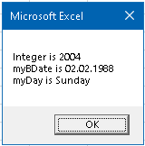
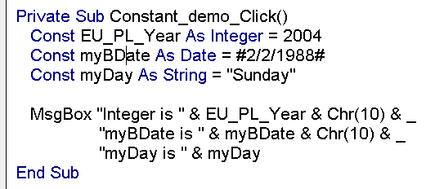
Constants
Syntax:
Const constant_name As constant_type = constant_value
A constant is a value that does not change.
vbCrLf constant used to interrupt a line of text and move to the next line.
PI - 3.1415926535897932
NULL - Built-in Logical Constants
Black | vbBlack | &h00
Red | vbRed | &hFF
Green | vbGreen | &hFF00
Yellow | vbYellow | &hFFFF
Blue | vbBlue | &hFF0000
Magenta | vbMagenta | &hFF00FF
Cyan | vbCyan | &hFFFF00
White | vbWhite | &hFFFFFF
Notes:
Private Sub Constant_demo_Click()
Const EU_PL_Year As Integer = 2004
Const myBDate As Date = #2/2/1988#
Const myDay As String = "Sunday"
MsgBox "Integer is " & EU_PL_Year & Chr(10) & _
"myBDate is " & myBDate & Chr(10) & _
"myDay is " & myDay
End Sub

Slide 63
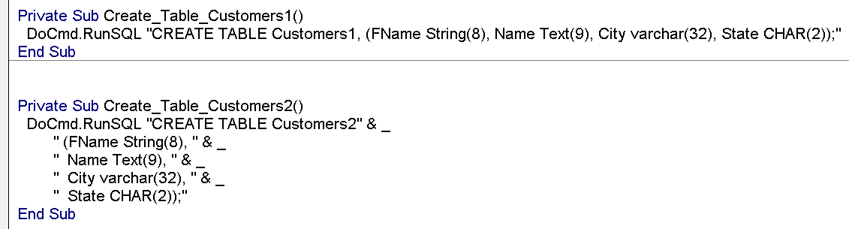
Examples
Private Sub Create_Table_Customers()
DoCmd.RunSQL "CREATE TABLE Customers (FName String(9), LName Text(16), City varchar(32), State CHAR(2));"
End Sub
Private Sub Create_Table_Students()
DoCmd.RunSQL "CREATE TABLE Students (StudentNumber LONG, Age BYTE, Grade INTEGER, Discipline LONGTEXT);"
End Sub
Private Sub Create_Table_Pupils()
DoCmd.RunSQL "CREATE TABLE Pupils (Std_ID String(7), Age REAL, Height FLOAT, Weight NUMBER);"
End Sub
Private Sub Command_OPEN()
DoCmd.SelectObject acTable, "Students", True
DoCmd.OpenTable "Students"
End Sub
Private Sub Command_List_TABLES()
Dim obj As AccessObject
Dim dbs As Object
Set dbs = Application.CurrentData
For Each obj In dbs.AllTables ' Check each object of the AllTables collection
MsgBox obj.Name ' When you find a table, display its name
Next obj
End Sub
Notes:
Private Sub Create_Table_Customers1()
DoCmd.RunSQL "CREATE TABLE Customers1, (FName String(8), Name Text(9), City varchar(32), State CHAR(2));"
End Sub
Private Sub Create_Table_Customers2()
DoCmd.RunSQL "CREATE TABLE Customers2" & _
" (FName String(8), " & _
" Name Text(9), " & _
" City varchar(32), " & _
" State CHAR(2));"
End Sub

